Slide 1
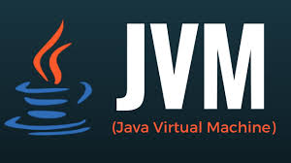
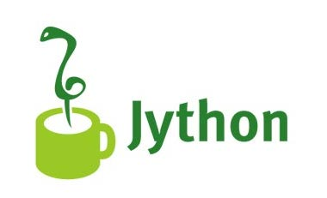
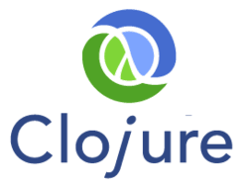
Alternatives for

Slide 2
Jython
Jython = Java + Python
Python running on JVM
Was created in 1997 as Jpython
As Jython since January 17, 2001
Current release 2.7.1

Slide 3

Jython
Python Software License
www.jython.org
Jim Hugunin (Numeric Python extensions)

Slide 4
Jython
CPython = Python on C since 2001
python.org

Slide 5
Jython
PyPy = Python on RPython since 2007
pypy.org
RPython = Restricted Python

Slide 6
Jython
IronPython = Python on C# since 2006
ironpython.net

Slide 7
Demo

Slide 8
Clojure
Dialect of Lisp programming language
LISP = LISt Processor
Lisp running on JVM
Appeared in 2007
Current stable release 1.8

Slide 9
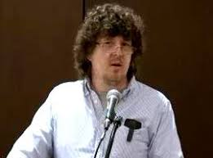
Clojure
Eclipse Public License
clojure.org
Rick Hickey

Slide 10
Clojure
ClojureScript transpiler to JavaScript
Google Closure
clojurescript.org

Slide 11


Clojure
Leiningen project automation tool
leiningen.org
Since 2009
Phil Hagelberg
Jean Niklas L'orange

Slide 12
Clojure
Reagent an interface between ClojureScript and React
https://reagent-project.github.io/

Slide 13
Clojure
A ClojureScript UI framework and client/server architecture over Facebook's React.
https://github.com/omcljs/om/

Slide 14
Clojure
las3r Clojure on ActionScript Virtual Machine
clojure-py Clojure on Python
rouge Clojure atop YARV in Ruby
cljPerl Clojure atop Perl
Pixie, Clojure-inspired Lisp dialect writen in RPython

Slide 15
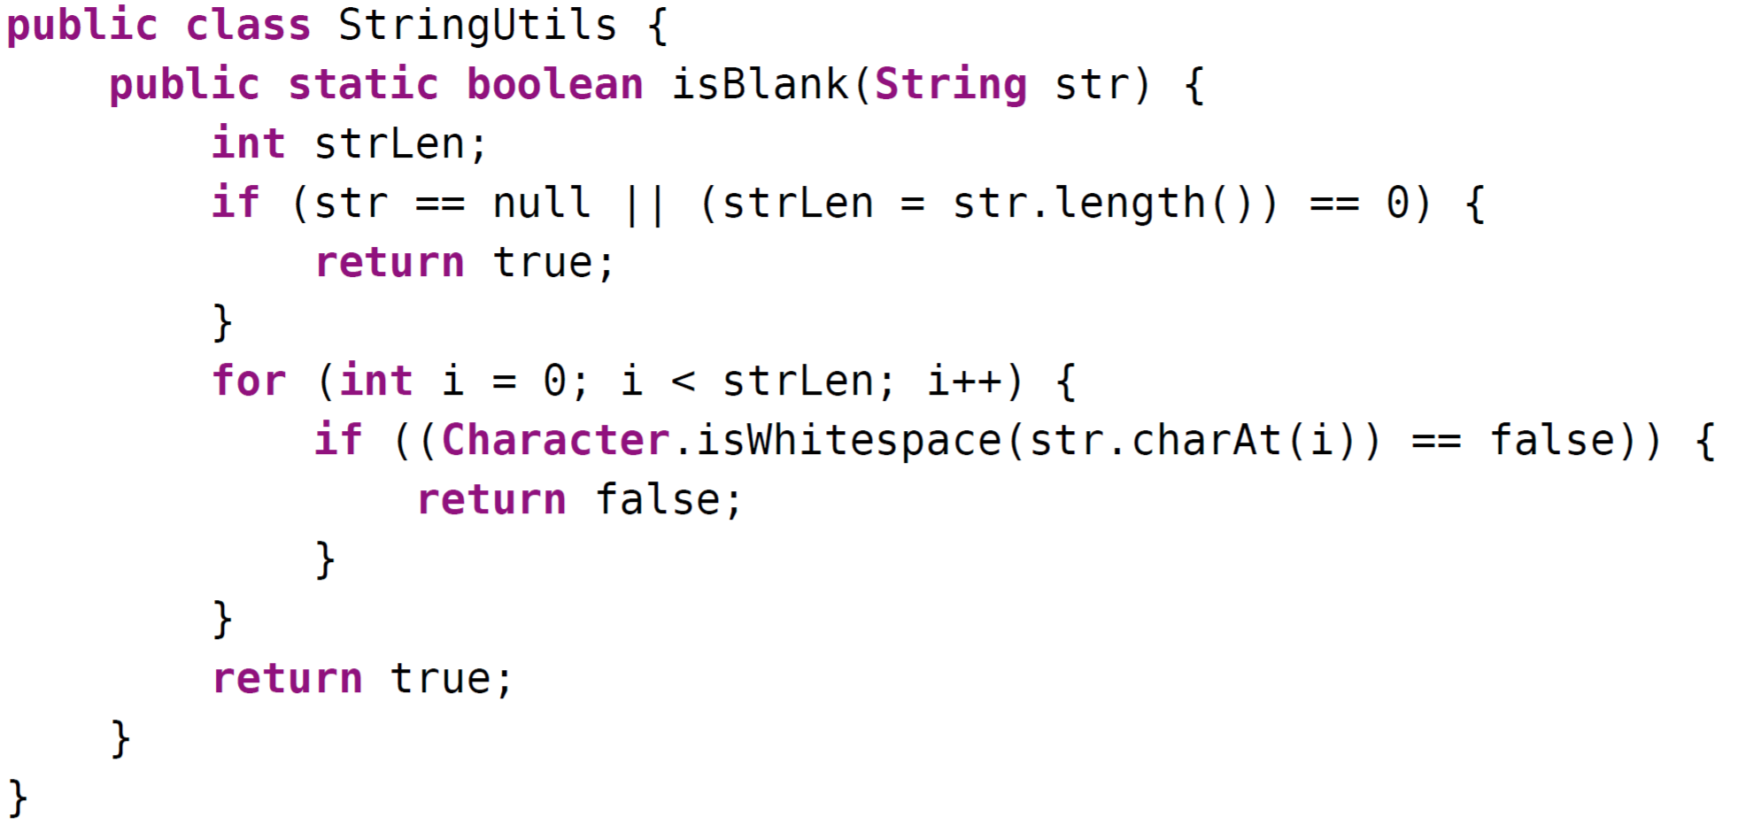
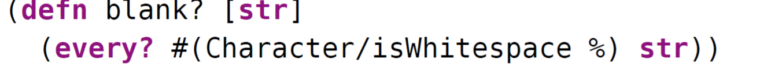
Java and Clojure Comparison

Slide 16
Demo

Slide 17
Conclusions
State of the Art
TypeScript: strong typed JavaScript
Clojure and Jython: dynamic languages on JVM
Pixie = Clojure in RPython (Rjython)
List of another high-profile JVM Programming Languages:
  Apache Groovy
  Scala
  Kotlin
  JRuby

Slide 18
Before next conference
Area1650 Cups

Slide 19
Thanks for your time

